Slide 1

AppliedData Sience
VIDYAA VIKAS COLLEGE OF ENGINEERING AND TECHNOLOGY
Nivya.EV

Slide 2

Table of
CONTENTS
MODEL SELECTION,
TRAINING AND TESTING,
EVALUATION,
VISUALIZATION,
OPTIMIZATION,
DEPLOYMEN,
IMPORTING THE REQURIED LIBERIES,
IMPORTING THE DATA SET,
HANDLIMG THE MISSING DATA,
ENCODING CATEGORICAL DATA,
SPLITING THE DATA SET,
FEATURE SCALING.

Slide 3
INTRODUCTION
LStock market prediction is the act of trying to determine the future value of a company stock or other financial instrument traded on an exchange. The successful prediction of a stock's future price could yield significant profit.
One is Efficient Market Hypothesis (EMH) and another one is Random Walk Theory. Random walk theory: Random walk theory assumes that it is impossible to predict stock prices as stock prices don't depend on past stock.

Slide 4
MODEL SELECTION
Choose the appropriate machine learning or deep learning models for stock price prediction. Common models include ARIMA, LSTM, and various regression models.
mport pandas as pd
import numpy as np
from sklearn.linear_model
import LinearRegression
from sklearn.model_selection
import train_test_split from sklearn.metrics
import mean_squared_error

Slide 5
VISUALIZATION
Utilize bar charts or other types of visualizations to present your analysis and results. Bar charts can be helpful for displaying trends and patterns in the data.
# Preprocess visualization
X = data.drop('Price', axis=1)
y = data['Price']

Slide 6

Optimization
FINE-TUNE YOUR MODEL BY ADJUSTING HYPERPARAMETERS OR TRYING DIFFERENT ALGORITHMS TO IMPROVE ITS ACCURACY.
#Optimization
sets X_train
, X_test, y_train, y_test = train_test_split(X, y, test_size=0.2, random_state=42)

Slide 7
Deploymen
F THE MODEL PERFORMS WELL, CONSIDER DEPLOYING IT AS A TOOL FOR INVESTORS. THIS MIGHT INVOLVE CREATING A USER-FRIENDLY INTERFACE OR INTEGRATING IT WITH A TRADING PLATFORM
model = LinearRegression()
model.fit(X_train, y_train)
mse = mean_squared_error(y_test, y_pred)
print('Mean Squared Error:', mse)

Slide 8
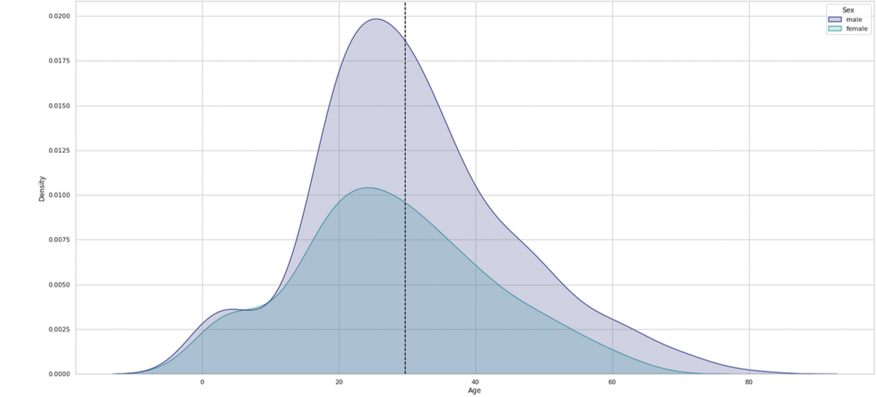
STOCK PRICE PRETUCTIONT

Slide 9
IMPORTING THE REQURIED LIBERIES
# IMPORTING THE REQUIRED LIBRARIES
IMPORT PANDAS AS PD
IMPORT NUMPY AS NP FROM SKLEARN.MODEL_SELECTION IMPORT TRAIN_TEST_SPLIT FROM SKLEARN.LINEAR_MODEL
IMPORT LINEARREGRESSION
# READING THE DATASET DATA =
PD.READ_CSV("DATA.CSV")
# EXPLORING THE DATASET
PRINT(DATA.HEAD())

Slide 10

importing the requried liberies
notes
- THE `PANDAS` LIBRARY IS USED TO READ AND MANIPULATE THE DATASET.
- The `numpy` library is used for mathematical operations.
- The `train_test_split` function from `sklearn.model_selection` is used to split the dataset into training and testing sets.
- The `LinearRegression` class from `sklearn.linear_model` is used to create the Linear Regression model.

Slide 11
IMPORTING THE DATA SET
# IMPORTING THE REQUIRED LIBRARIESIMPORT PANDAS AS PD
# Reading the dataset
data = pd.read_csv("data.csv")
# Creating a matrix from the dataset
matrix = data.values
# Exploring the matrixprint(matrix)

Slide 12
importing the data set
notes
- THE `PANDAS` LIBRARY IS USED TO READ THE DATASET AND PERFORM DATA MANIPULATION.
- The `read_csv` function is used to read the dataset from a CSV file. Make sure to replace "data.csv" with the actual file name and path.
- The `values` attribute is used to convert the dataset into a matrix.
- The resulting matrix will contain the values from the dataset without the column names or indices.

Slide 13
handling the missing data
IMPORTING THE REQUIRED LIBRARIES
IMPORT PANDAS AS PD FROM SKLEARN.IMPUTE
IMPORT SIMPLEIMPUTER
# READING THE DATASET DATA = PD.READ_CSV("DATA.CSV")
# CHECKING FOR MISSING DATAPRINT(DATA.ISNULL().SUM())
# CREATING AN INSTANCE OF SIMPLEIMPUTER IMPUTER = SIMPLEIMPUTER(STRATEGY='MEAN')
# HANDLING MISSING DATA DATA_FILLED = IMPUTER.FIT_TRANSFORM(DATA)

Slide 14
Handling the missing data
notes
THE `PANDAS` LIBRARY IS USED TO READ THE DATASET, AND THE `SKLEARN.IMPUTE` MODULE FROM THE `SKLEARN.PREPROCESSING` LIBRARY IS USED TO HANDLE MISSING DATA.
- The `read_csv` function is used to read the dataset from a CSV file. Make sure to replace "data.csv" with the actual file name and path.
- The `isnull()` function is used to check for missing values in the dataset. The `sum()` function is then used to count the number of missing values in each column.

Slide 15
encoding categorical data
# IMPORTING THE REQUIRED LIBRARIESIMPORT PANDAS AS P
# Reading the dataset
data = pd.read_csv("data.csv")
# Encoding categorical data using one-hot encoding
data_encoded=pd.get_dummies(data, columns=["Category"])
#Exploringtheencoded dataprint(data_encoded.head())

Slide 16
encoding categorical data
notes
- THE `PANDAS` LIBRARY IS USED TO READ THE DATASET AND PERFORM DATA ENCODING.
- The `read_csv` function is used to read the dataset from a CSV file. Make sure to replace "data.csv" with the actual file name and path.
- The `get_dummies` function is used to perform one-hot encoding on the categorical columns. The `columns` parameter specifies the columns to encode.
- The resulting `data_encoded` dataframe will have the categorical columns replaced with their one-hot encoded counterparts.

Slide 17
spliting the data set
# IMPORTING THE REQUIRED LIBRARIESI
MPORT PANDAS AS PD FROM SKLEARN.MODEL_SELECTION
IMPORT TRAIN_TEST_SPLIT
# READING THE DATASET DATA

Slide 18
spliting the data set
notes
THE `PANDAS` LIBRARY IS USED TO READ THE DATASET, AND THE `TRAIN_TEST_SPLIT` FUNCTION FROM THE `SKLEARN.MODEL_SELECTION` MODULE IS USED TO SPLIT THE DATA.
- The `read_csv` function is used to read the dataset from a CSV file. Make sure to replace "data.csv" with the actual file name and path.
- The dataset is split into features (X) and the target variable (Y). Replace "target_column" with the actual column name you want to predict.
- The `train_test_split` function is used to split the dataset into training and test sets. The `test_size` parameter specifies the proportion of the dataset to be allocated to the test set.
- The resulting datasets are assigned to `X_train`, `X_test`, `Y_train`, and `Y_test`.
- You can check the shapes of the resulting datasets using the `shape` attribute.

Slide 19
feature scaling
# IMPORTING THE REQUIRED LIBRARIES
IMPORT PANDAS AS PD FROM SKLEARN.PREPROCESSING IMPORT STANDARDSCALER
# READING THE DATASET DATA = PD.READ_CSV("DATA.CSV")
# SPLITTING THE DATASET INTO FEATURES (X) AND TARGET (Y) X = DATA.DROP("TARGET_COLUMN", AXIS=1)
# REPLACE "TARGET_COLUMN" WITH THE ACTUAL COLUMN NAME Y = DATA["TARGET_COLUMN"]
# REPLACE "TARGET_COLUMN" WITH THE ACTUAL COLUMN NAME
# CREATING AN INSTANCE OF STANDARDSCALER SCALER = STANDARDSCALER()

Slide 20
feature scaling
notes
THE `PANDAS` LIBRARY IS USED TO READ THE DATASET, AND THE `STANDARDSCALER` CLASS FROM THE `SKLEARN.PREPROCESSING` MODULE IS USED TO PERFORM FEATURE SCALING.
- The `read_csv` function is used to read the dataset from a CSV file. Make sure to replace "data.csv" with the actual file name and path.
- The dataset is split into features (X) and the target variable (Y). Replace "target_column" with the actual column name you want to predict.
- The `StandardScaler` class is used to perform feature scaling. An instance of the scaler is created

